Slide 1

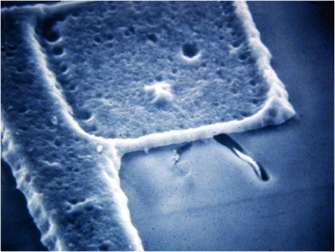
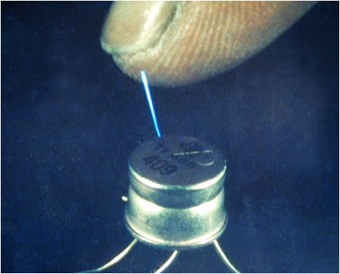

Electrostatic Discharge
ESD Basics and Protection
Notes:
Class recommended length;
Classroom presentation – 45 minutes (make it interactive, ask questions, don’t read from the slides)
Practical exercises – 30 minutes (depends on the # of students)
Assessment, including review – 15 minutes
Management presentation – 20 minutes
Required materials;
ESD Training presentation on PC with a digital projector or overhead slides of the ESD Training presentation
Student handout, 1 per student
created by printing this presentation using the File - Print function, Print What: Handouts, Slides per Page = 3
Copy of the assessment sheet for each student
Copy of the abbreviated ESD Checklist for each student
Pair of heel straps and wrist strap for each student (or a few they can share)
ESD log sheet
ESD heel strap and wrist strap tester
REFRESHER TRAINING SHOULD INCLUDE THE PRESENTATION ONLY – PRACTICAL EXERCISES ARE NOT REQUIRED

Slide 2
About Transforming Technologies
Transforming Technologies is a leading solution provider for static control in the electronics industry. We offer over 10 years experience in providing electrostatic solutions to manufacturing facilities; protecting products and processes from the many serious problems associated with static electricity.
Headquartered in Toledo, OH, USA, Transforming Technologies we offer a wide range of unique and exceptional ESD products to prevent, eliminate an monitor electrostatic charges.
We provide comprehensive knowledge of electrostatic issues, and above all outstanding, friendly service. We call it Static Care™.
Notes:
Stress the importance of not carrying ESDS parts and assemblies around without the proper carriers.
The should NOT carry assemblies across the floor just in their hands, without an ESD safe container.

Slide 3
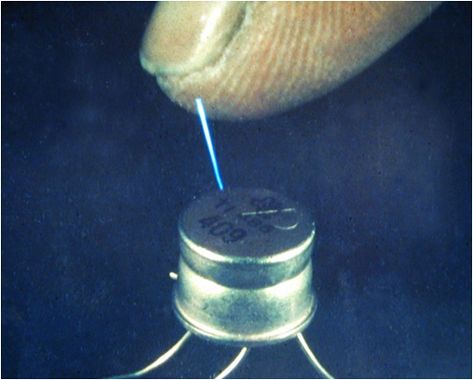
What is ESD?
ESD definition
Common causes of ESD
Sources of ESD
Types of ESD damage
Photo of ESD arcing from finger to component
Notes:
Before you go to the next slide, ask the students what ESD is.
You may want to write their answers on the whiteboard or a flipchart.

Slide 4
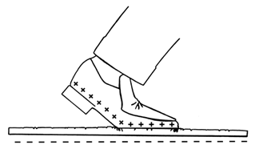
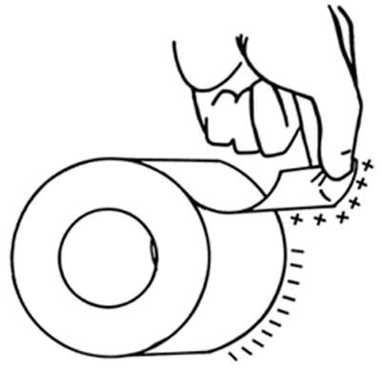
ESD Definition
ESD – Electrostatic Discharge: The transfer of an electrostatic charge between bodies at different electrical potentials.
  Also referred to as static electricity
  Electrostatic charge is most commonly created by the contact and separation of two materials which results in Tribocharging
.
.
Notes:
Briefly talk about the amount of static charges created by the different means. Ask them if they’ve felt the shock of walking across the carpet and touching the door knob. Did it hurt? What do you think it would do to a component?
RH = Relative Humidity, as the amount of humidity decreases, as it gets drier, the static charges increase.
It does not take a lot of energy to destroy a circuit in a module that is made with has line widths of 0.2 micrometer (.0000002 meters – a hundred time smaller than a human hair)

Slide 5
ESD Is the Hidden Enemy
There are innumerable ESD events occurring all the time that we cannot see or feel.
.
.
People Feel ESD at 2000 Volts!!!!
Component damage - can occur with as little as 15 – 30 Volts!!!!
Notes:
Briefly talk about the amount of static charges created by the different means. Ask them if they’ve felt the shock of walking across the carpet and touching the door knob. Did it hurt? What do you think it would do to a component?
RH = Relative Humidity, as the amount of humidity decreases, as it gets drier, the static charges increase.
It does not take a lot of energy to destroy a circuit in a module that is made with has line widths of 0.2 micrometer (.0000002 meters – a hundred time smaller than a human hair)

Slide 6
Typed of Materials that Charge
Conductors
  Materials that easily transfer electric charge
  Can be used to transfer charge to earths ground
  Examples
      Metals
      Water
      Carbon
      People
Insulators
  Materials that hold an electric charge and can not easily transfer the charge
  Can not be grounded to earth by common means
  Examples
      Plastics
      Glass
      Dry Air
.
.
Notes:
Briefly talk about the amount of static charges created by the different means. Ask them if they’ve felt the shock of walking across the carpet and touching the door knob. Did it hurt? What do you think it would do to a component?
RH = Relative Humidity, as the amount of humidity decreases, as it gets drier, the static charges increase.
It does not take a lot of energy to destroy a circuit in a module that is made with has line widths of 0.2 micrometer (.0000002 meters – a hundred time smaller than a human hair)

Slide 7
Sources of ESD
The following items are examples of materials that generate and hold electrostatic charge.
  Vinyl binders
  Equipment covers
  Plastic document holders/sheet protectors
  Post-ItTM notes
  Plastic pens
  Bubble wrap
  Plastic housings on equipment
  Paper, schematics, etc.
  Plastic work travelers
  Plastic spray bottles
  Personal items
    Purses
    Sweaters/jackets
    Insulated lunch totes
    Combs/brushes
    Lotion bottles
Notes:
Review the above examples of materials that create ESD.
Ask for additional examples of things that create ESD.

Slide 8
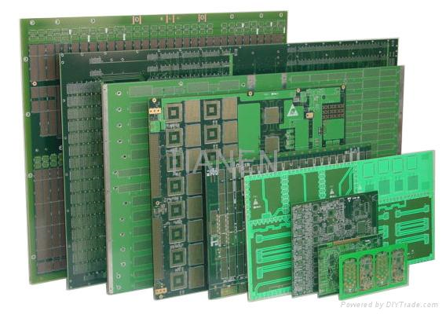
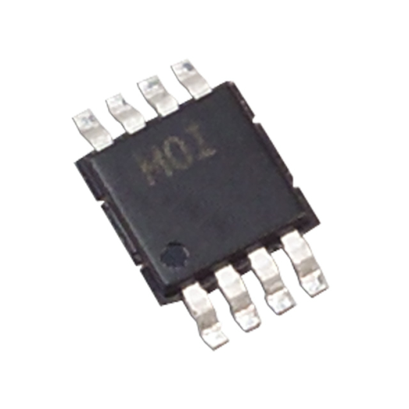
What type of Materials are ESD Sensitive?
ESDS – Electrostatic Discharge Sensitive
Integrated Circuits (DIPs, QFP, BGA, SOT, etc.)
    Crystals and oscillators
    Printed Circuit Board Assemblies
    When in doubt, treat it as ESDS!
Notes:
Bring examples of ESD Sensitive devices if possible.
Stress the point that parts should be treated as ESDS unless they are absolutely sure they are not.

Slide 9
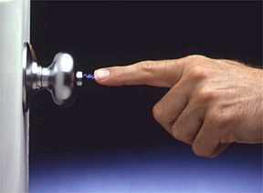
Common Causes of ESD
  Opening a common plastic bag
  Removing adhesive tape from a roll or container
  Walking across a floor and grabbing the door knob
  Transporting computer boards or components around in their trays on non-ESD carts
  Sliding circuit boards on a work bench
Notes:
As the students for other examples that create static electricity.

Slide 10
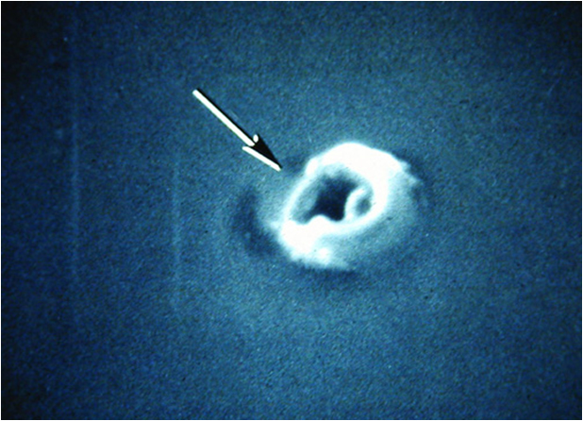
Types of ESD Damage
CATASTROPHIC FAILURE
  A device is exposed to ESD and it no longer works
  The device circuitry is permanently damaged
  Such failures may be caught when tested, before shipment
LATENT FAILURE
  A device is exposed to ESD and is partially damaged, yet it continues to work
  The product may have a failure after the user places it in service
Image of the ESD damage after removal of the capacitor metallization.
Magnification is 10,500 times
Notes:
Ask the students to discuss what type of failure is worst and why.
Latent failures are worst because they can happen in our customer’s facility or in the ultimate Customer’s facility, causing they to be frustrated.
Ask them how they felt when they got something home and it failed after a short time. Ask them to give examples from their personal life.

Slide 11
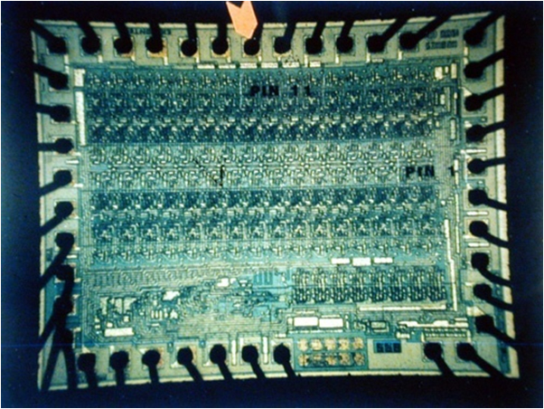
Example of ESD Damage
  Optical photo of a large Integrated Circuit which has experienced ESD damage to the pin noted by the arrow.
Notes:
Ask the students to discuss what type of failure is worst and why.
Latent failures are worst because they can happen in our customer’s facility or in the ultimate Customer’s facility, causing they to be frustrated.
Ask them how they felt when they got something home and it failed after a short time. Ask them to give examples from their personal life.

Slide 12
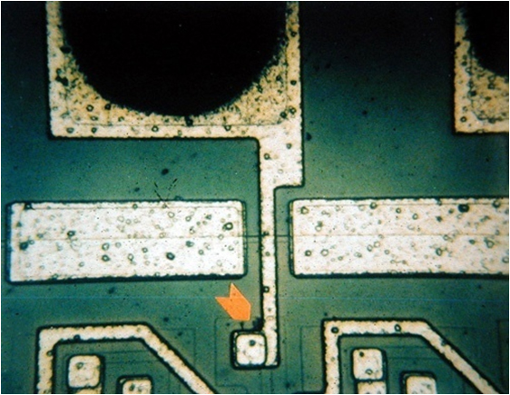
Example of ESD Damage
  Higher magnification photo of pin noted by the arrow in the prior slide This taken at 400 times magnification on a 4" X 5" photo. The damage is noted as the "fuzz" at the end of the arrow.
Notes:
Ask the students to discuss what type of failure is worst and why.
Latent failures are worst because they can happen in our customer’s facility or in the ultimate Customer’s facility, causing they to be frustrated.
Ask them how they felt when they got something home and it failed after a short time. Ask them to give examples from their personal life.

Slide 13
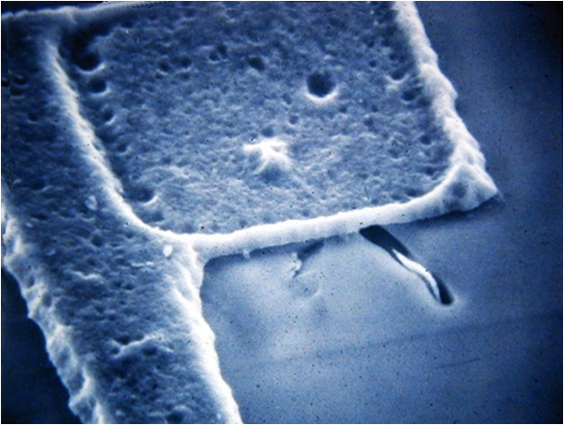
Example of ESD Damage
  Overlying glassivation has been removed and the surface decorated to show the ESD damage at 5,000 times magnification in this scanning electron micrograph.
Notes:
Ask the students to discuss what type of failure is worst and why.
Latent failures are worst because they can happen in our customer’s facility or in the ultimate Customer’s facility, causing they to be frustrated.
Ask them how they felt when they got something home and it failed after a short time. Ask them to give examples from their personal life.

Slide 14

Why is ESD Important?
Electrostatic Discharge (ESD) can damage sensitive electronic devices, resulting in:
  Higher manufacturing costs
      Rework
      Repair
      Scrap
  Lower production yields
  Unhappy customers
      Shorter product life
      Reduce product reliability
Estimates of actual cost of ESD damage to the electronics industry = $$$ Billions annually
Notes:
Make sure to point out the negative affects that ESD has on our business and our customers, especially, the unhappy customers when our products fail on them!
Ask the students if they’ve ever bought a product and it failed soon after they started using it.
How did it make them fail?
How do you think our customers feel when products we built for them fail?

Slide 15

How to control ESD?
ESD Control Program
  ESD Training
  ESD Control Areas
  Ground Conductors
  Ionization
  ESDS Component Handling and Storage
Notes:
This is a review of our ESD Control Program, the steps we take to reduce and/or eliminate ESD

Slide 16

ESD Control Program
  The first step in ESD control is to train all personnel who may come in contact with static sensitive materials
    Proper use of personal grounding equipment such as heel grounders or wrist straps
    Personnel should understand ESD
    equipment test methods and documentation
    Understanding of other ESD control methods such as ionization

Slide 17
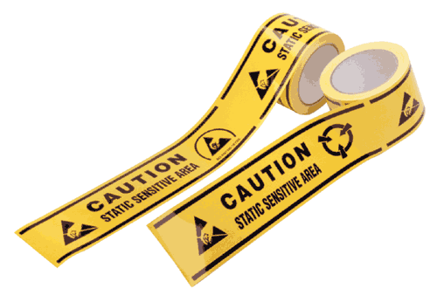
ESD Control Program
  Any area where unprotected ESD sensitive parts and assemblies may be handled shall be designated an ESD Control Area, and must meet the following requirements;
    The area is free from non-essential static generators, and the risk from process-essential static generators is minimized
    All personnel must be grounded and grounding equipment must be tested daily
    All movable carts, racks, etc. are grounded
    The area is labeled as an ESD control area, and the boundaries are clearly marked

Slide 18

Create an ESD Control Area
  Any area where unprotected ESDS parts and assemblies may be handled
  ESD areas must be labeled with posted signs and their boundaries marked
Notes:
Ask the students to name areas that are ESD Control areas.
How do they know? Is there a sign? Is the boundaries clearly marked? How?

Slide 19
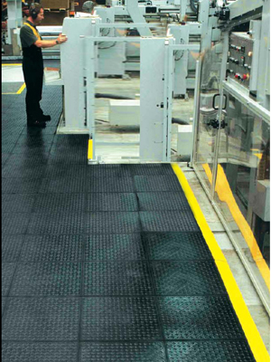
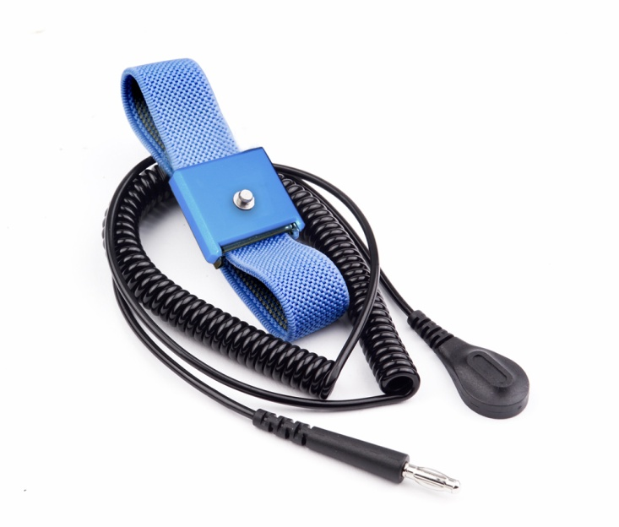
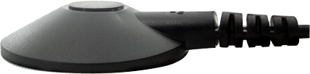
ESD Control Program Cont.
  All Conductors within the EPA must be grounded
    Personal Grounding: All personnel, including visitors
    Work surfaces and flooring
    All equipment in EPA

Slide 20
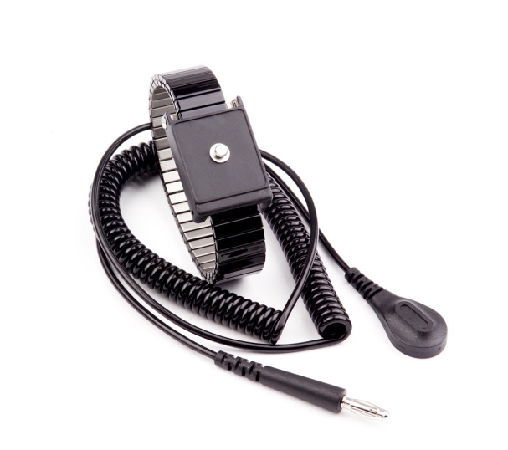
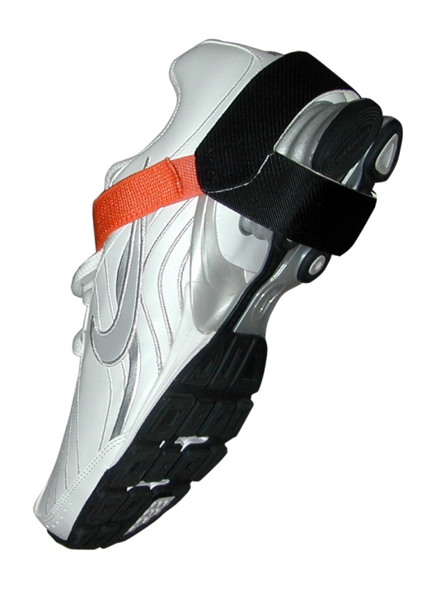
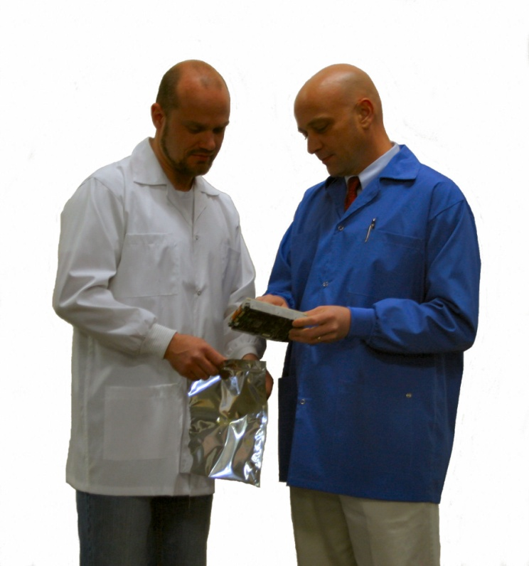
Personal Grounding
Wrist Straps and Coil Cords
  Wrist Straps ground personnel at workstations
Heel Grounders
  Ground mobile personnel in areas where there are ESD floors
Smocks
  Smock sleeves should be in contact with the skin, clothing underneath should not show
Notes:
ESD shoes are acceptable as long as the ESD tag is visible.
Stress that Heel straps should not be worn outside because it’ll wear them out and cause them to fail.
Heel straps must be tested and pass on a daily basis.

Slide 21
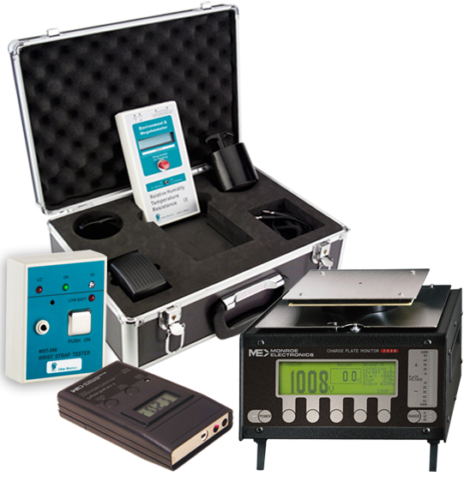
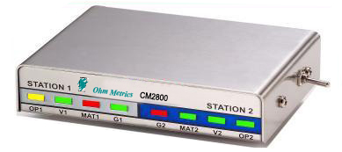
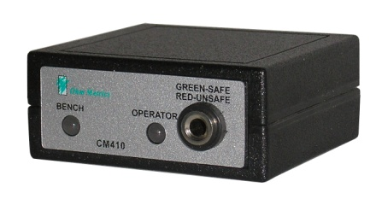
Personal Grounding
All Personal Grounding Equipment Should be Tested or Monitored Daily
  Wrist Strap and Footwear Testing Stations
  ESD ground monitoring
    Constant
    Impedance
OHM Metrics and Monroe Electronics
Test and Measurement Products
CM Series
ESD Workstation Monitors
Notes:
ESD shoes are acceptable as long as the ESD tag is visible.
Stress that Heel straps should not be worn outside because it’ll wear them out and cause them to fail.
Heel straps must be tested and pass on a daily basis.

Slide 22
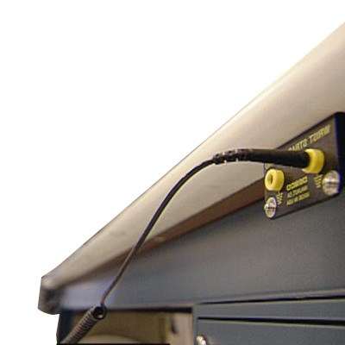
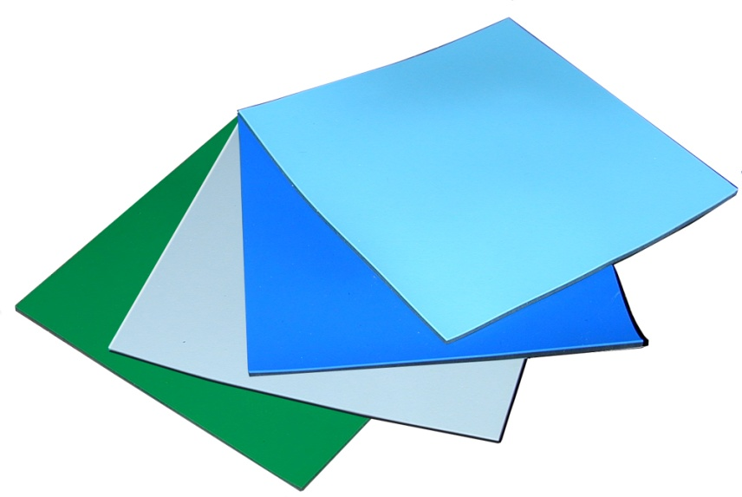
Equipment Grounding
Work Stations and Tables
  Must have static dissipative surfaces connected to the building ground source.
  Must have wrist strap ground connections (2 recommended), preferably banana jack receptacles, connected in parallel to the bldg ground source
  Should be cleaned daily with an antistatic cleaner
Notes:
Ask the students to always make a quick check whenever sitting at a workstation to ensure the table and wrist strap receptacles are connected to ground.
Ask the students what should they do if the ESD workstation is not grounded?
Suggested actions;
They should not work at an ungrounded workstation with ESDS parts and assemblies.
They should inform their supervisor and the Area ESD Representative immediately
If the problem is not corrected quickly, they should notify the ESD Coordinator and the next level management.

Slide 23
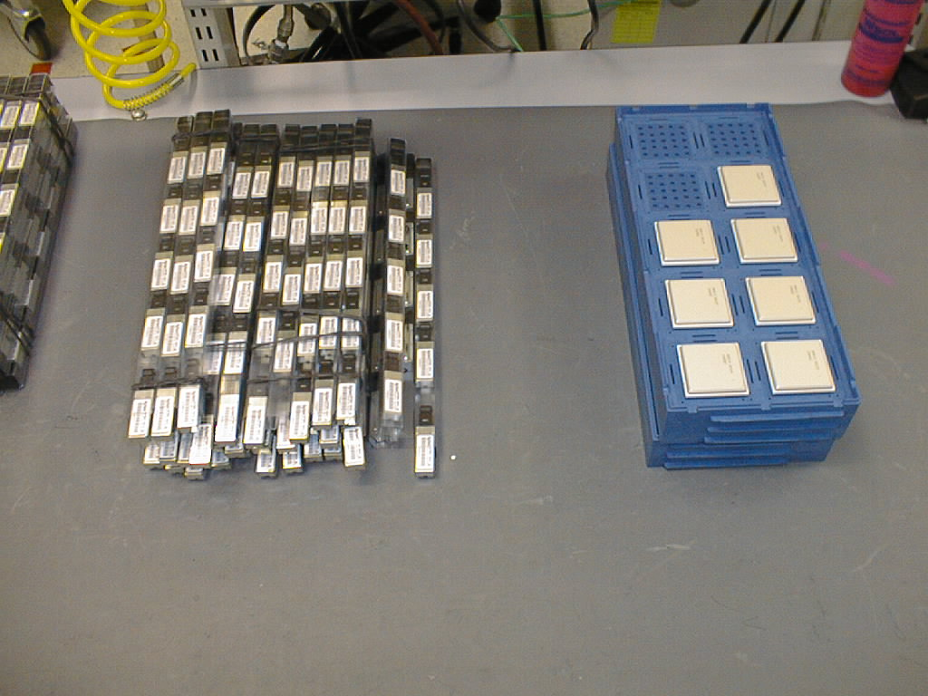
Equipment Grounding
Shelving and Cabinets
  Must provide a grounded surface unless the parts remain fully enclosed within shielding-type packaging
Storage Bins
  All parts bins and containers must be static dissipative or antistatic
  Whenever practical, sensitive parts should remain in the original container until assembled
Notes:
If a power tool does not have a 3 prong plug, bring it to your Supervisor’s attention.
Stress the importance of leaving ESDS parts in their original protective container until assembles.

Slide 24
Ionization
Many times, equipment or objects(insulators) are unable to be grounded in which case air ionizers should be used.
What is Ionization?
Air Ionizers use a process called "neutralization" to remove static charge from insulators that cannot be grounded.
  Ionizers produce positively and negatively charged ions and floods ESD area with Ions.
  Ions are charged particles that are present in the air, and as opposites attract, charges will be neutralized over time.
Notes:
Ask the students to always make a quick check whenever sitting at a workstation to ensure the table and wrist strap receptacles are connected to ground.
Ask the students what should they do if the ESD workstation is not grounded?
Suggested actions;
They should not work at an ungrounded workstation with ESDS parts and assemblies.
They should inform their supervisor and the Area ESD Representative immediately
If the problem is not corrected quickly, they should notify the ESD Coordinator and the next level management.

Slide 25
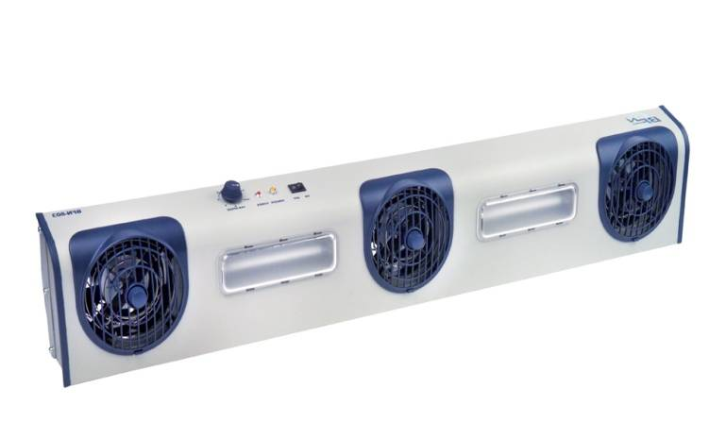
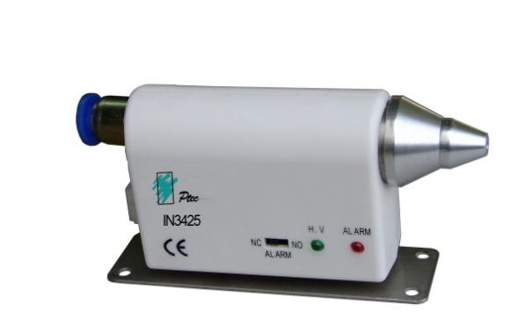
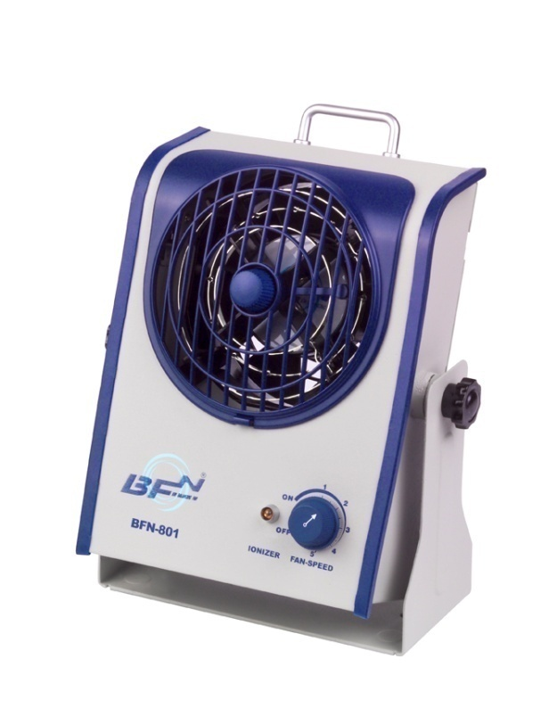
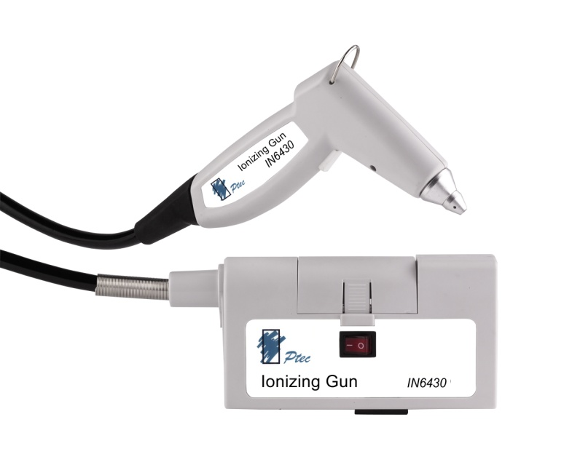
Types of Air Ionizers
  Bench Top
  Ionizing Nozzles
  Air Guns
  Overhead Ionizers
Notes:
Ask the students to always make a quick check whenever sitting at a workstation to ensure the table and wrist strap receptacles are connected to ground.
Ask the students what should they do if the ESD workstation is not grounded?
Suggested actions;
They should not work at an ungrounded workstation with ESDS parts and assemblies.
They should inform their supervisor and the Area ESD Representative immediately
If the problem is not corrected quickly, they should notify the ESD Coordinator and the next level management.

Slide 26
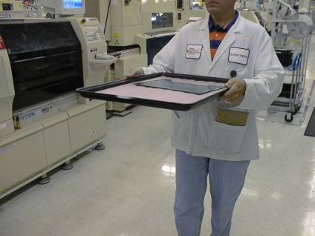
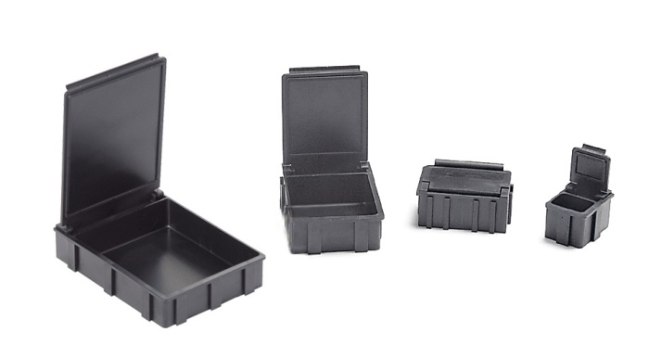
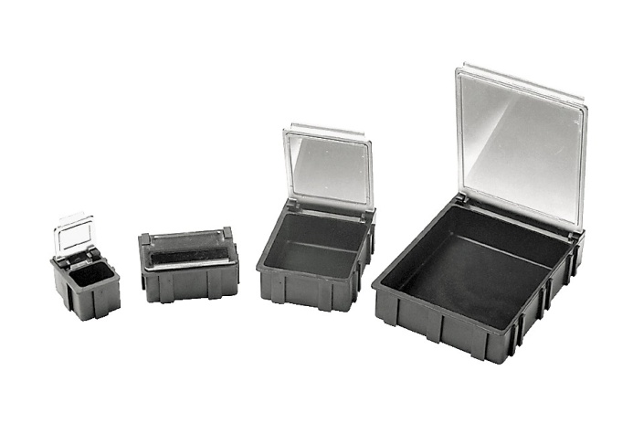
ESDS Component Handling and Storage
To move ESDS parts or assemblies inside an ESD control area, use one of the following;
  Static dissipative containers
  Static shielding containers
  Conductive containers or board carriers
  Ground movable racks
Surface Mount Devices
SMD Boxes
Notes:
Stress the importance of not carrying ESDS parts and assemblies around without the proper carriers.
The should NOT carry assemblies across the floor just in their hands, without an ESD safe container.

Slide 27
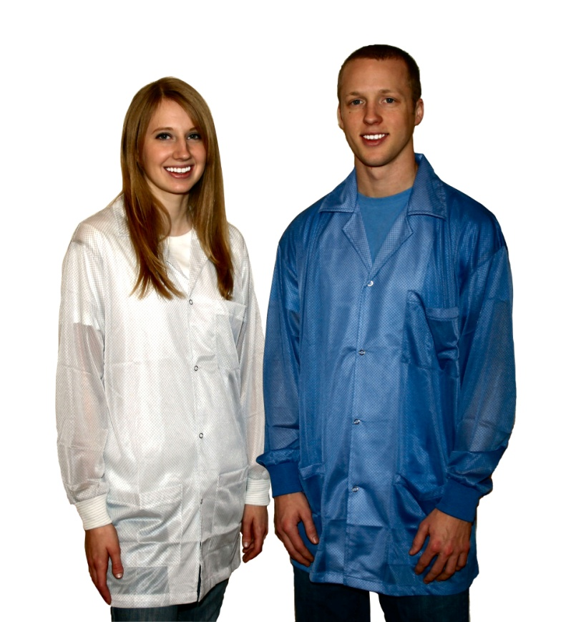
ESD Basics Review
Things to remember about an ESD protection plan.
  Only allow trained or escorted people in EPA
  Ground all conductors including people at ESD workstation
  Test wrist straps at least daily, or use continuous monitors
  Test ESD footwear at least daily, if used
  Visually check all grounding cords
  Keep wristband snug, foot grounder grounding tab in shoe, and ESD smocks buttoned
  Ionizers are maintained and air flow directed at ESDS items
  Use shielded packaging for shipping or storing ESD sensitive items outside the ESD Protected Area
  Handle unpacked ESDS items only when grounded
Notes:
Stress the importance of not carrying ESDS parts and assemblies around without the proper carriers.
The should NOT carry assemblies across the floor just in their hands, without an ESD safe container.

Slide 28
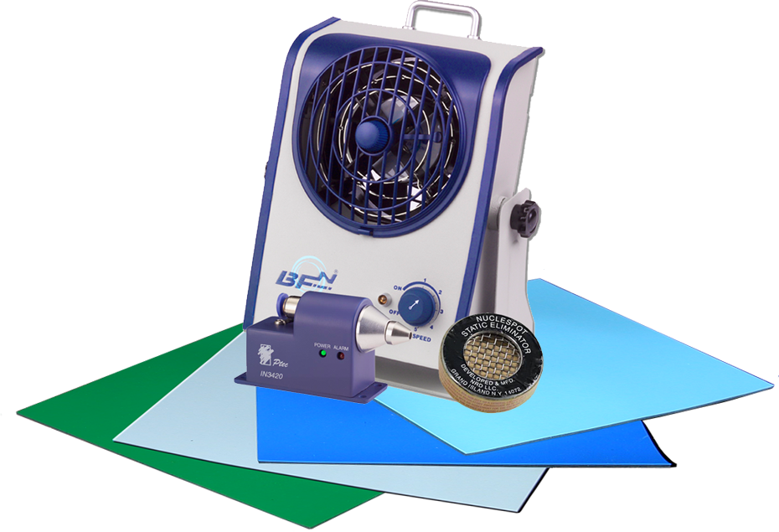
About Transforming Technologies
Transforming Technologies is a leader in static protection, offering a wide range of unique and exceptional ESD products to prevent, eliminate and monitor electrostatic charges.
  Constant Monitors
  ESD Apparel: ESD Hot Glove, ESD Jackets
  Ionization: Alpha, Bench Top, Overhead, Gun, Nozzles
  Personal Grounding: Coil Cords, Wrist Straps, Footwear, Grounding Cords
  SMD Boxes
  Surface Protection: Rubber, Vinyl, PVC
  Test and Measurement Equipment
Notes:
Stress the importance of not carrying ESDS parts and assemblies around without the proper carriers.
The should NOT carry assemblies across the floor just in their hands, without an ESD safe container.

